Slide 1


SmartPot
Principles of digital fabrication
University of Oulu
25th April 2019
Tiberio Galbiati | Xiao Zifan | Jussi Pavainen | Tapio Immonen

Slide 2
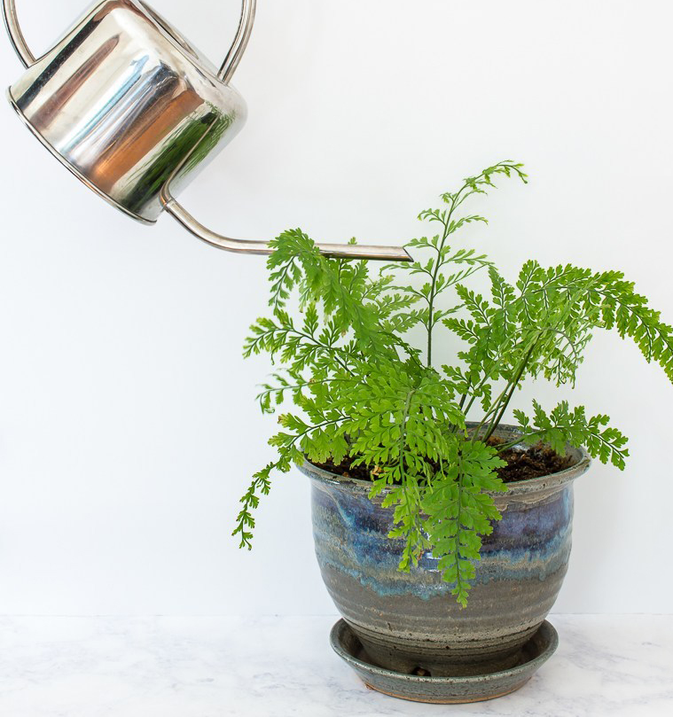

Never water
your flower
again by yourself!

Slide 3
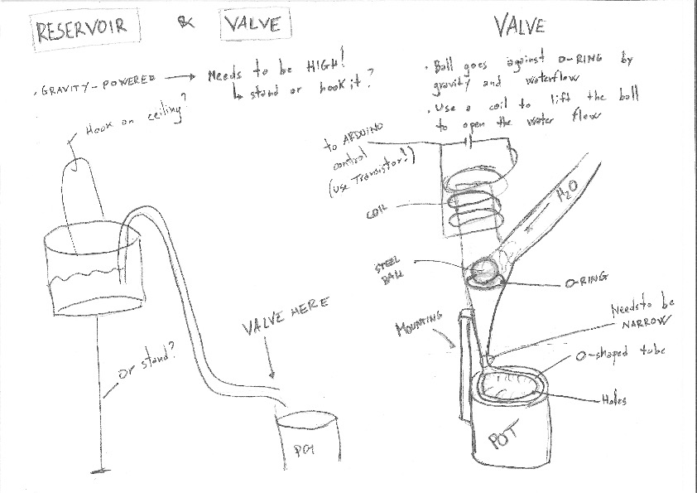
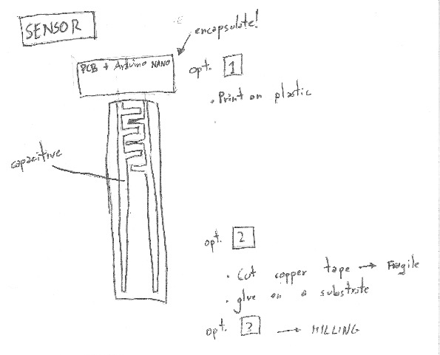
From sketches

Slide 4
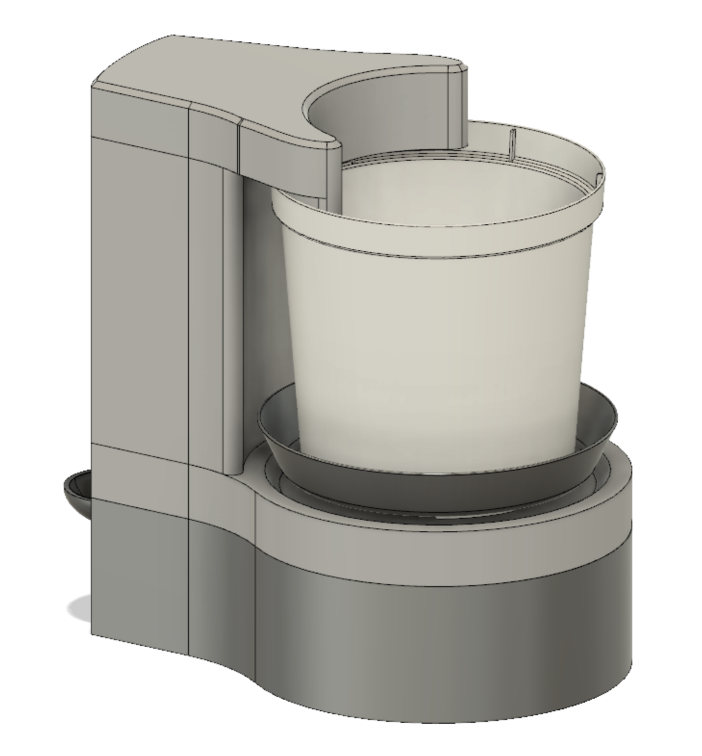

Better sketches

Slide 5
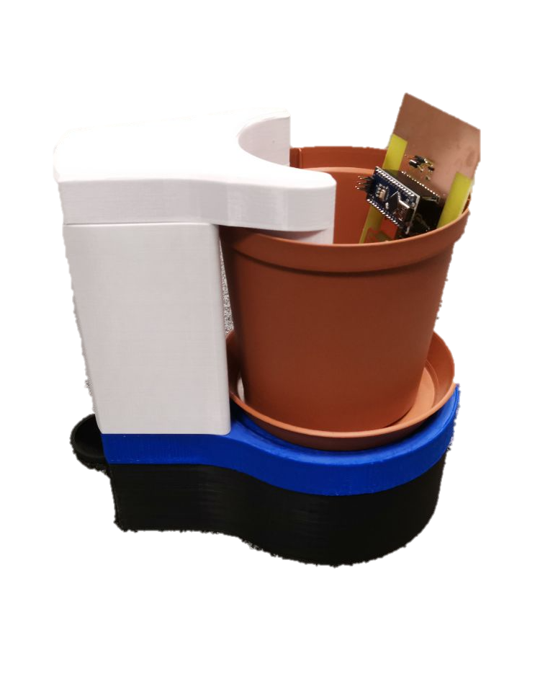
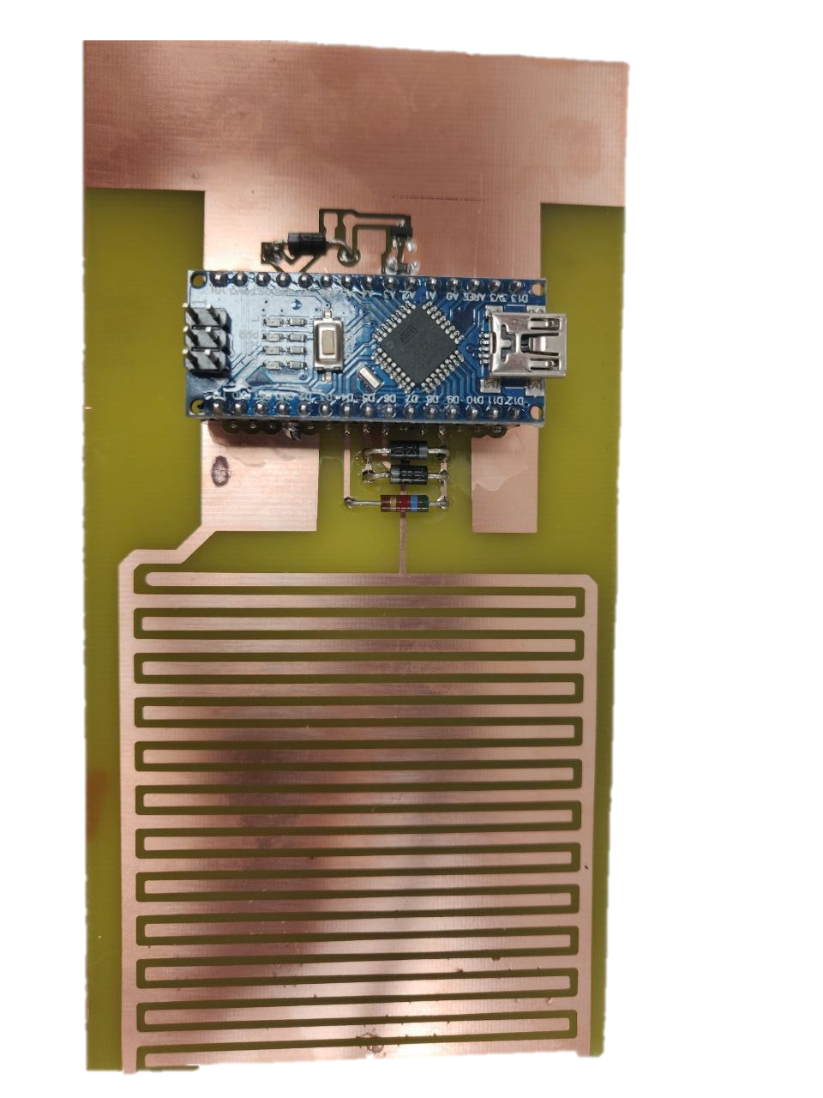
Prototype

Slide 6
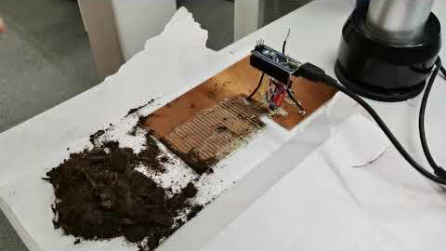
The sensor – it works!
http://tiberiog.cacsite.com/tiberiog.cacsite.com/xiao/itworks.mp4

Slide 7
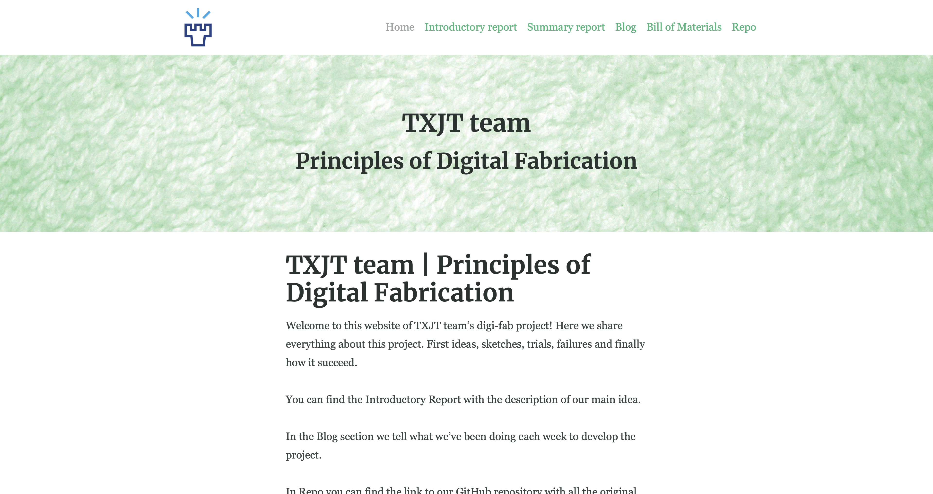
Our documentation – txjt.ml

Slide 8
What’s next
Putting things together: pump & sensor
Buy a real flower
Do a timelapse of working project

Slide 9
Tiberio Galbiati | Xiao Zifan | Jussi Pavainen | Tapio Immonen

